Slide 1



Mapping Crustal Lunar Magnetic Fields in Polar Regions
Jacob van der Leeuw
Dr. Lon Hood, University of Arizona Lunar and Planetary Laboratory
2022 Arizona NASA Space Grant Statewide Symposium
April 23, 2022

Slide 2
Background
Lunar Crustal Magnetic Field Formation
  Iron-rich impactor hypothesis
Lunar Prospector (1999) + Kaguya (2009) Missions
  Missions collected Data on lunar magnetic field strength
Recreating polar maps using an Equivalent Source Dipole (ESD) technique
  Normalizes measurements to constant altitude

Slide 3
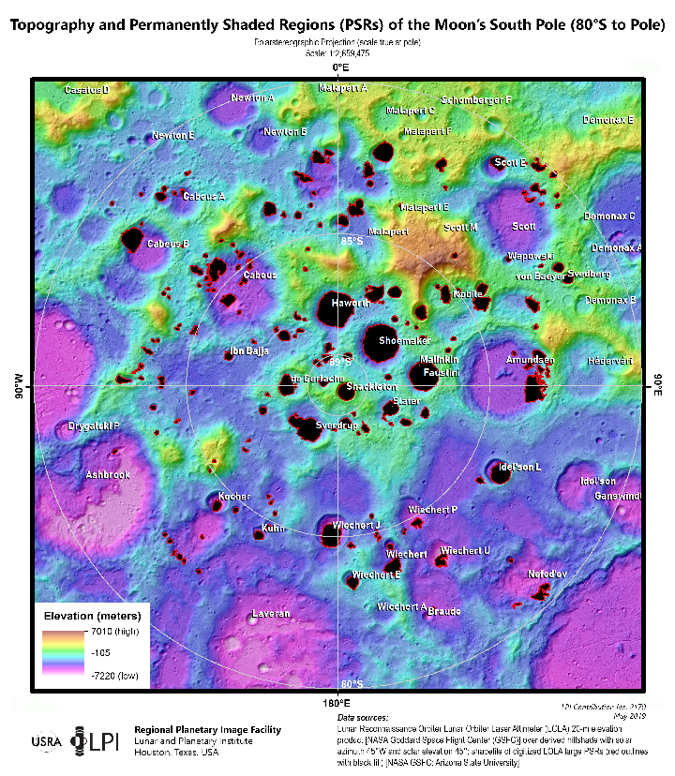
Project Motivation
Comparing maps with those previously generated at 30 km altitude by Tsunakawa
Interest in Southern Polar Region – future space missions
  Water ice in permanently shadowed craters
  Possible that the moon’s magnetic fields have deflected external charged particles that would cause water ice to be sputtered away

Slide 4
Methodology
Potential Anomaly
Created Stackplots from probe data
  For both polar regions, initially focused on 40 degree longitude regions with 10 degree overlap between regions
  Resulting orbits were then considered together to encompass the entire 360 degrees
  Noted prominent features and compared with known anomalies

Slide 5
Methodology
Chose orbits that did not possess significant noise and were generally at or below 30 km altitude
  Sometimes only ascending or descending parts of orbits could be used due to noisiness in data
  Noisiness defined as significant and prolonged deviation from the baseline field strength in nanoteslas (nT) possibly as a result of external magnetic fields
Identified as Noisy Data

Slide 6

Methodology
A previously developed root-mean-square (RMS) technique was utilized in order to determine if the orbits selected were viable (no short-term wavelength fluctuations)
However this did not eliminate all noise and so afterwards orbits were hand-selected
Magnetic field strength found by taking $√(nort{h field component}^{2}+eas{t field component}^{ 2}+radia{l field component}^{2})$
Results were converted from spherical into cylindrical coordinates for better smoothing and artifact reduction

Slide 7
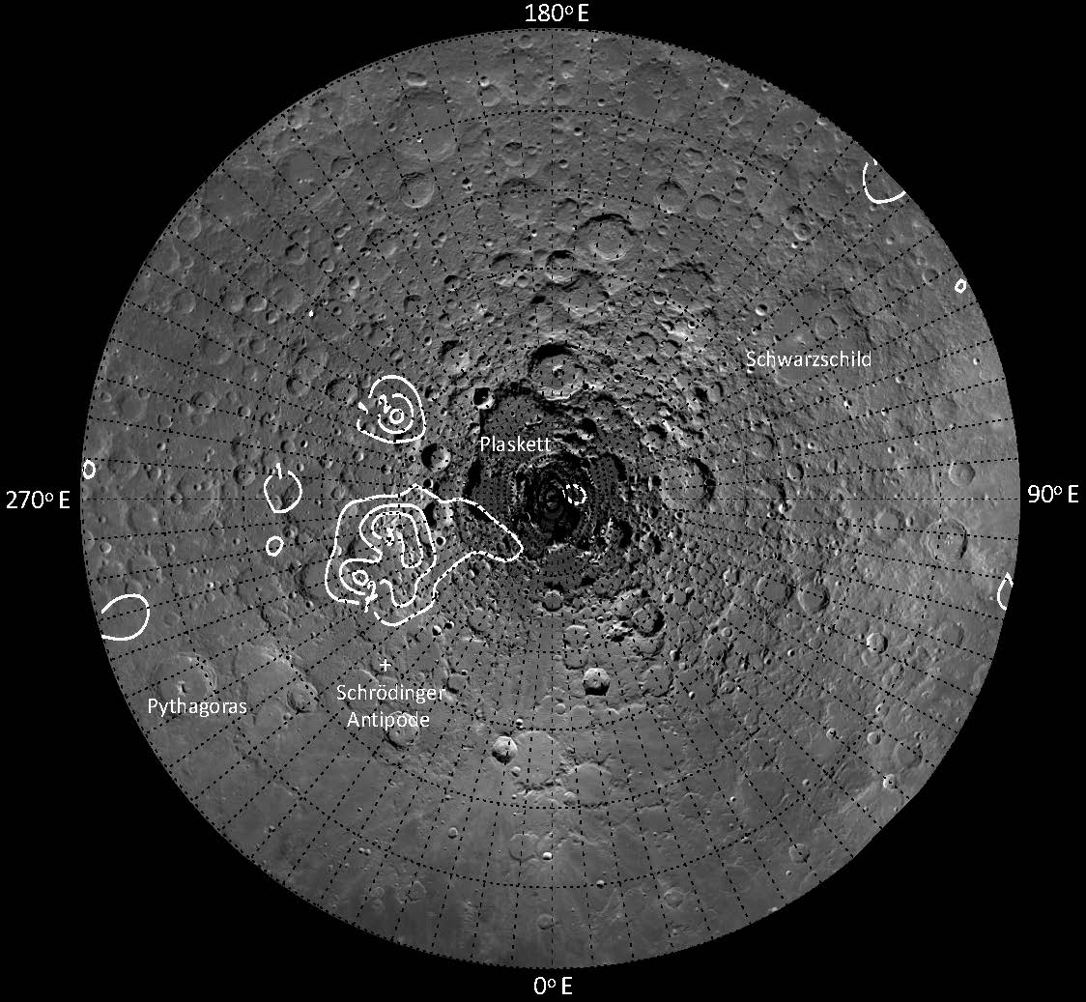
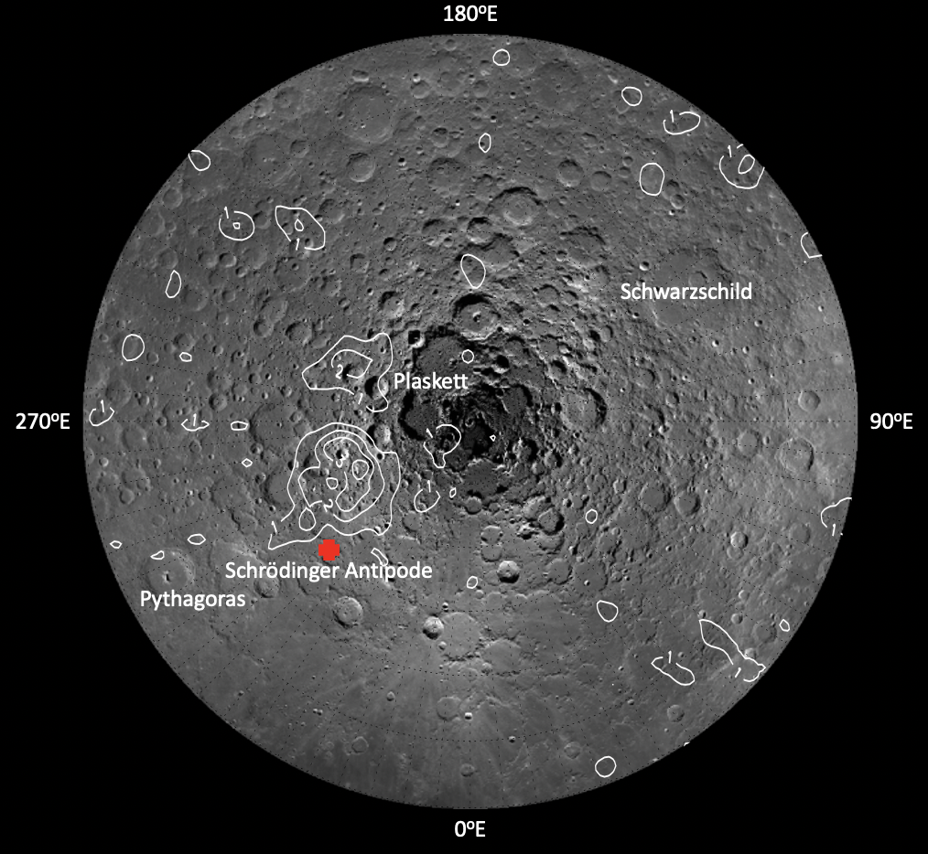
Northern Polar Region 30 km altitude
Tsunakawa et al. (2015) Map
2021-2022 Remapping

Slide 8
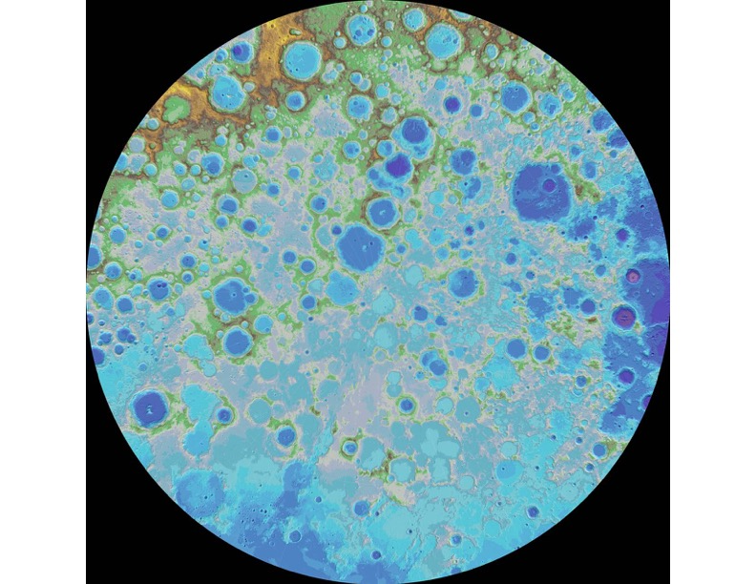
Northern Polar Region Topographic 30 km
180ºE
Schwarzschild
Plaskett
270ºE
90ºE
Schrödinger Antipode
Pythagoras
0ºE

Slide 9
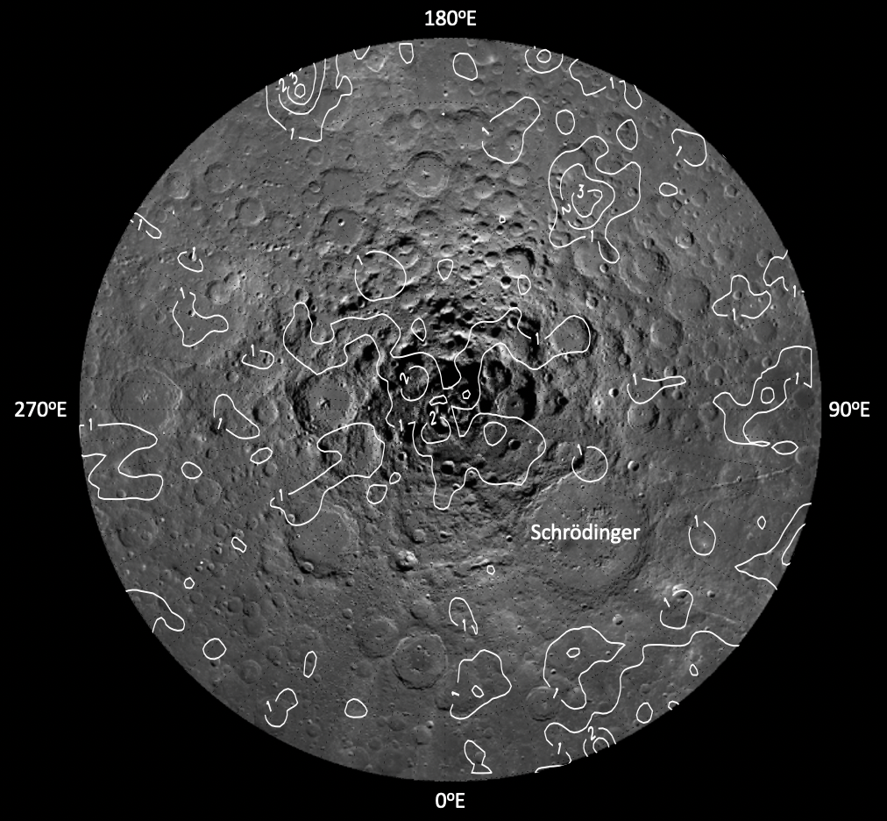
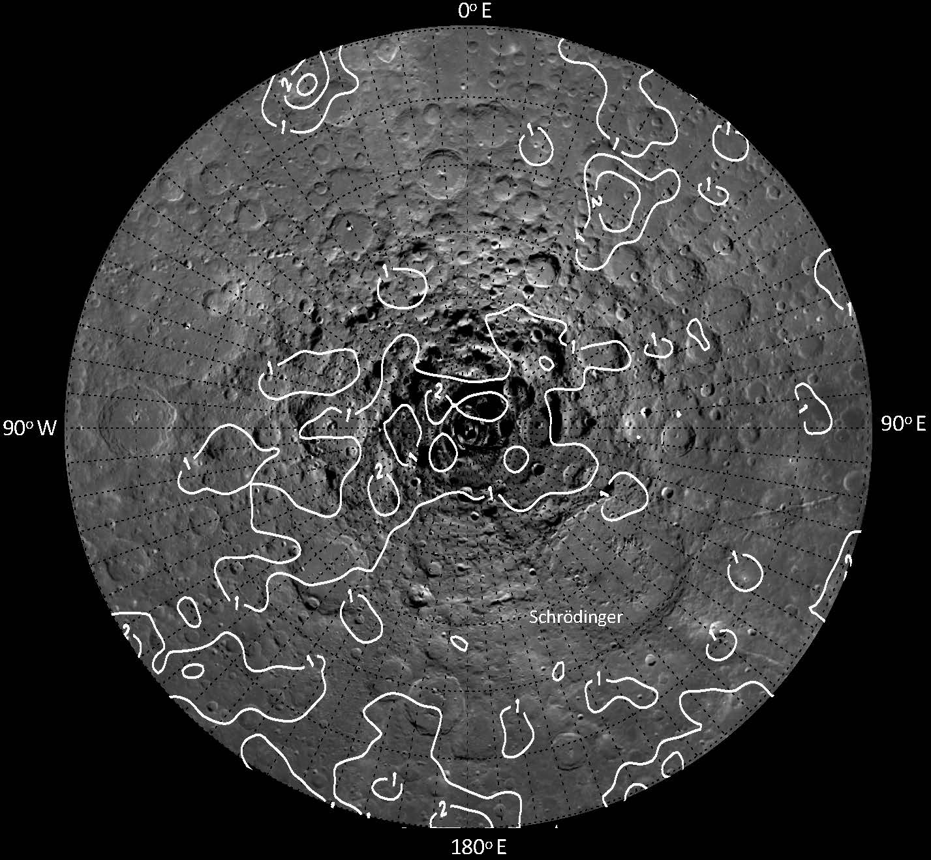
Southern Polar Region 30 km altitude
Tsunakawa et al. (2015) Map
2021-2022 Remapping

Slide 10
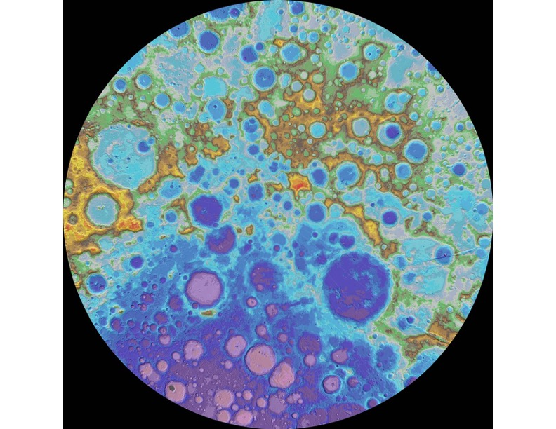
Southern Polar Region Topographic 30 km
180ºE
270ºE
90ºE
Schrödinger
0ºE

Slide 11
Conclusions
Anomalies are now more detailed than in the original Tsunakawa 30km mappings
New potential polar anomalies detected
Anomalies at antipodes of prominent craters such as Schrödinger
Some of the anomalies in the south pole are over permanently-shadowed craters where water ice potentially lies

Slide 12
Acknowledgements
Dr. Lon Hood, Lunar and Planetary Laboratory (LPL)
References
Hood, Lon et. al. MAGNETIC ANOMALIES OVER PERMANENTLY SHADOWED CRATERS NEAR THE LUNAR SOUTH POLE: MAPPING AND IMPLICATIONS, Lunar and Planetary Science Conference, 2022
Hood, Lon et. al. A new Large-Scale Map of the Lunar Crustal Magnetic Field and Its Interpretation, Lunar and Planetary Science Conference, 2021

Slide 13
THANK YOU

